Slide 1
Arquitetura e Organização de Computadores Portas Lógicas -LÓGICA BOOLEANA

Slide 2
A’ A~ (A.B)’ (A+B)’ A.B A+B

Slide 3
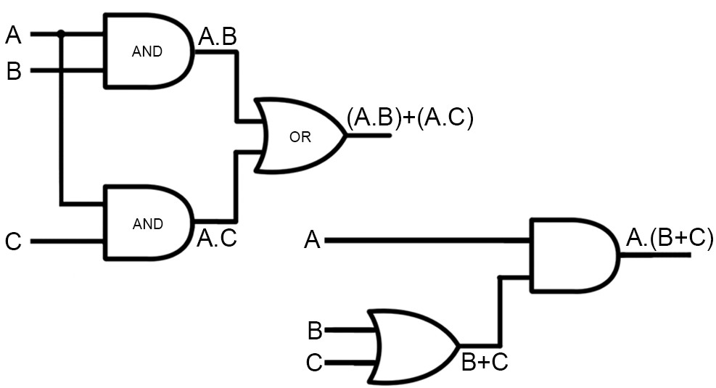
Exercício 1
A.(B+C) = (A.B)+(A.C)
2^{n}=número de linhas
n=número de entradas

Slide 4
A | B | C | A.B | A.C | (A.B)+(A.C)
0 | 0 | 0
0 | 0 | 1
0 | 1 | 0
0 | 1 | 1
1 | 0 | 0
1 | 0 | 1
1 | 1 | 0
1 | 1 | 1
2^{n}=número de linhas
n=número de entradas

Slide 5
A | B | C | B+C | A.(B+C)
0 | 0 | 0
0 | 0 | 1
0 | 1 | 0
0 | 1 | 1
1 | 0 | 0
1 | 0 | 1
1 | 1 | 0
1 | 1 | 1

Slide 6
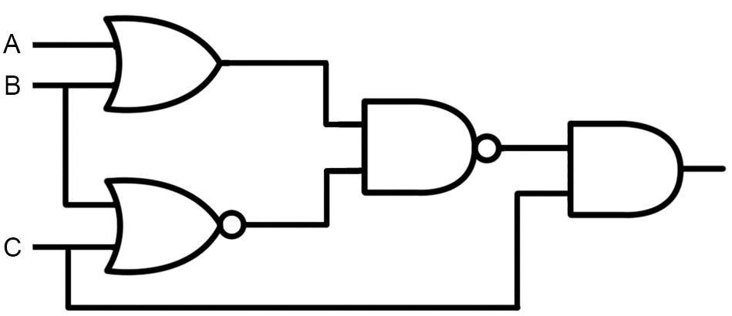
Exercício 2
A+B
(B+C)’

Slide 7
A | B | C | A+B | (B+C)’ | [(A+B).(B+C)’]’ | C.[(A+B).(B+C)’]’
0 | 0 | 0
0 | 0 | 1
0 | 1 | 0
0 | 1 | 1
1 | 0 | 0
1 | 0 | 1
1 | 1 | 0
1 | 1 | 1

Slide 8
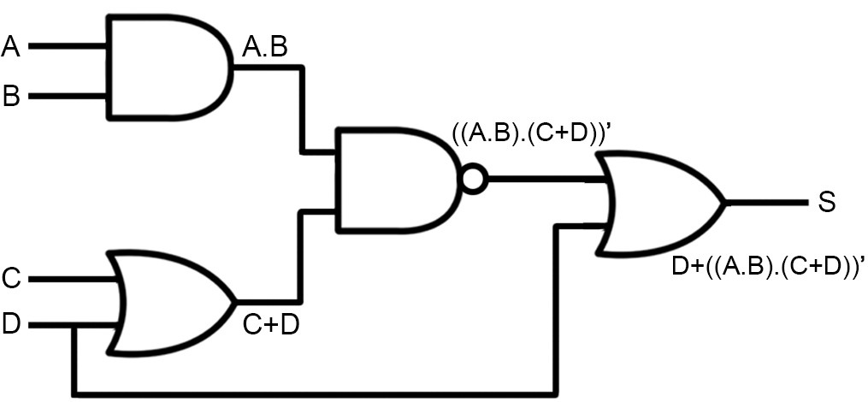
Exercício 3

Slide 9
A | B | C | D | A.B | C+D | ((A.B).(C+D))~ | D+((A.B).(C+D))~
0 | 0 | 0 | 0
0 | 0 | 0 | 1
0 | 0 | 1 | 0
0 | 0 | 1 | 1
0 | 1 | 0 | 0
0 | 1 | 0 | 1
0 | 1 | 1 | 0
0 | 1 | 1 | 1
1 | 0 | 0 | 0
1 | 0 | 0 | 1
1 | 0 | 1 | 0
1 | 0 | 1 | 1
1 | 1 | 0 | 0
1 | 1 | 0 | 1
1 | 1 | 1 | 0
1 | 1 | 1 | 1

Slide 10
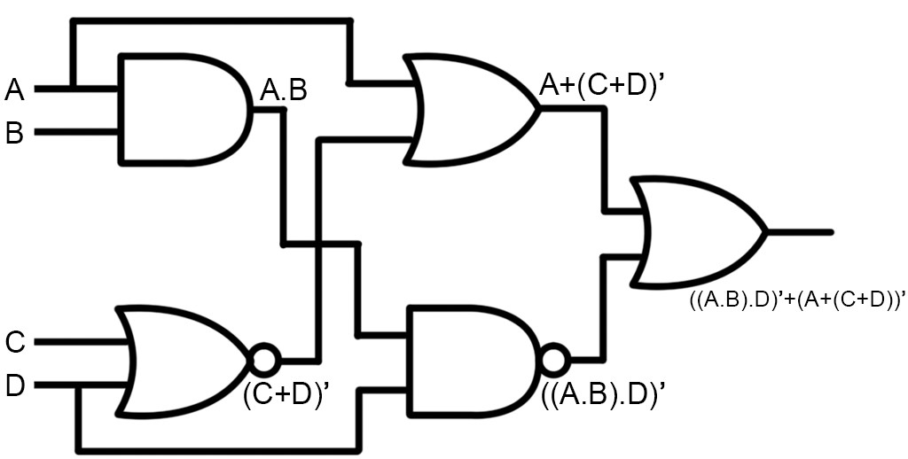
Exercício 4

Slide 11
A | B | C | D | A.B | ((A.B).D)’ | (C+D)’ | A+(C+D)’ | ((A.B).D)’+[A+(C+D)’]
0 | 0 | 0 | 0
0 | 0 | 0 | 1
0 | 0 | 1 | 0
0 | 0 | 1 | 1
0 | 1 | 0 | 0
0 | 1 | 0 | 1
0 | 1 | 1 | 0
0 | 1 | 1 | 1
1 | 0 | 0 | 0
1 | 0 | 0 | 1
1 | 0 | 1 | 0
1 | 0 | 1 | 1
1 | 1 | 0 | 0
1 | 1 | 0 | 1
1 | 1 | 1 | 0
1 | 1 | 1 | 1

Slide 12
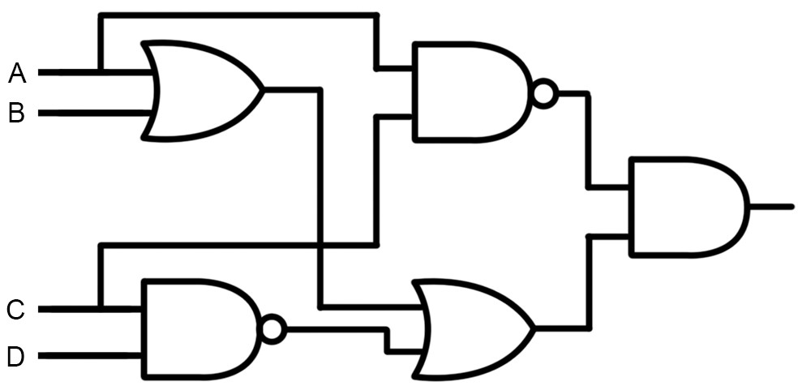
Exercício 5
A+B
(A.C)’
(C.D)’
(A+B)+(C.D)’

Slide 13
A | B | C | D | A+B | (C.D)’ | (A+B)+(C.D)’ | (A.C)’ | (A.C)’.((A+B)+(C.D)’)
0 | 0 | 0 | 0
0 | 0 | 0 | 1
0 | 0 | 1 | 0
0 | 0 | 1 | 1
0 | 1 | 0 | 0
0 | 1 | 0 | 1
0 | 1 | 1 | 0
0 | 1 | 1 | 1
1 | 0 | 0 | 0
1 | 0 | 0 | 1
1 | 0 | 1 | 0
1 | 0 | 1 | 1
1 | 1 | 0 | 0
1 | 1 | 0 | 1
1 | 1 | 1 | 0
1 | 1 | 1 | 1

